Slide 1
TEACHER CUE
CFU
HINT
Scaffolding for students
MAKE THE CONNECTION
Allow students to make the connection

Slide 2
HINT
Waste Cells Removal Respond Cells Energy
Sensitivity is the way in which organisms ____________to their environment.
Respiration is not only breathing. Instead, it is the conversion of _________ from carbohydrates that happens inside your ________.
Excretion is the ___________of ______ products from the body
All living organisms are made up of ______.

Slide 3
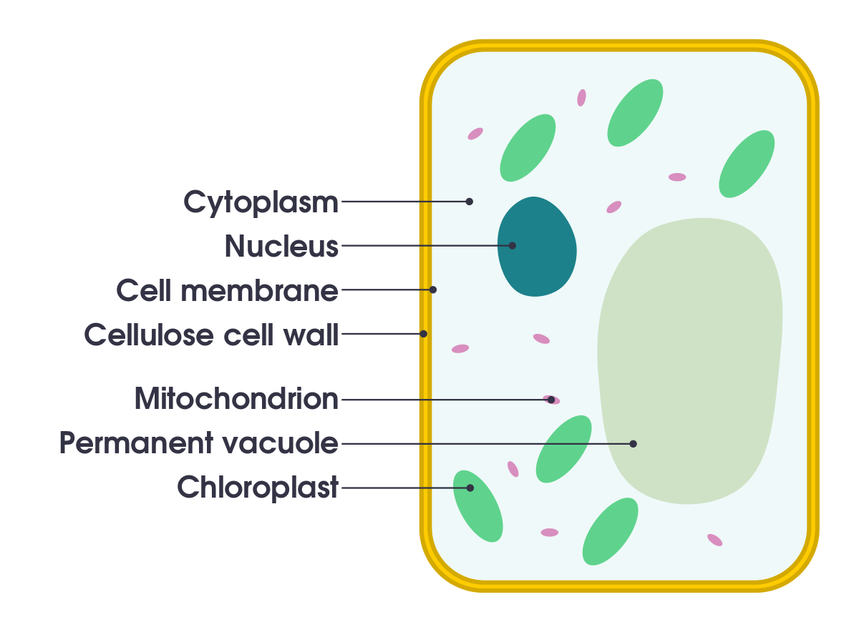
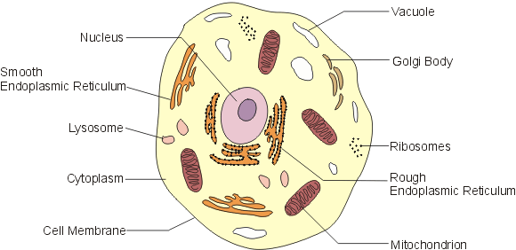
Which is which cell?

Slide 4
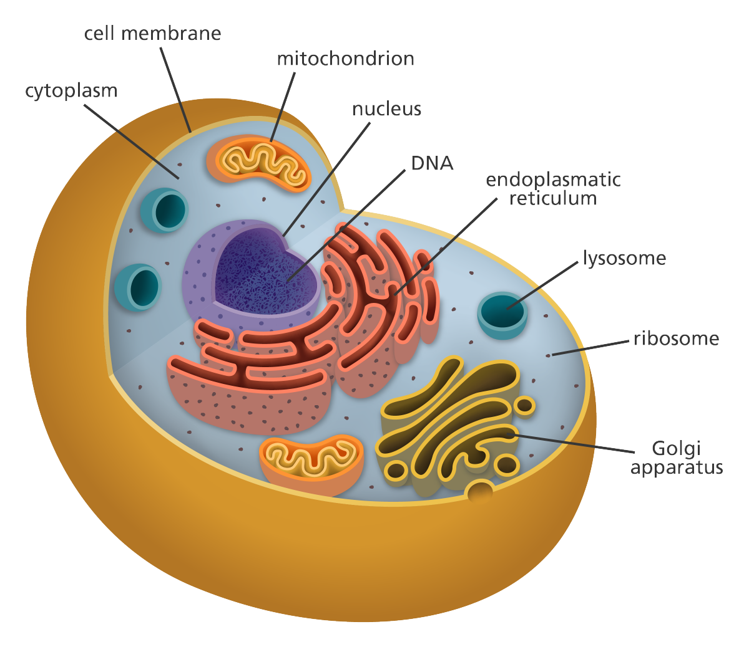
Match the term to the part of the cell

Slide 5
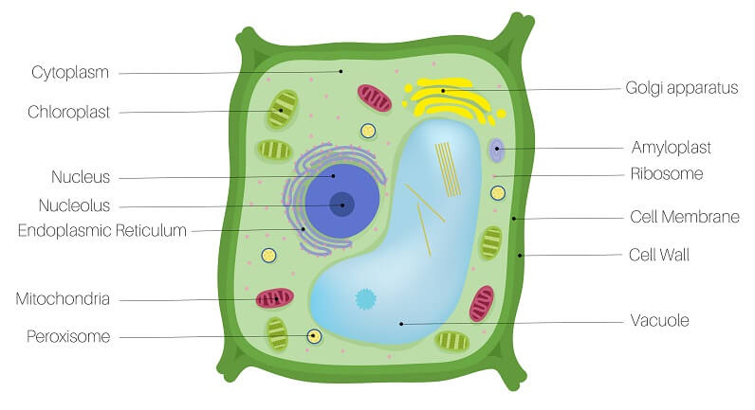

Slide 6
Match the term and the definition
Nucleus
Golgi apparatus
Ribosome
Chloroplast
Cell wall
Part of the cell that undergoes photosynthesis
Provides structural support in a plant cell and controls shape
Creates proteins in this part of the cell
Packages, modifies and sends proteins around the cell
Control centre of the cell that holds DNA, and regulates growth and metabolism

Slide 7
What are each of the stages in Mitosis
I
P lay
M inecraft
A t
T he
C rib

Slide 8
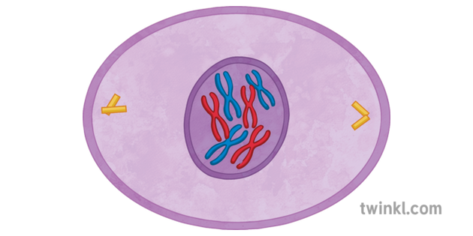
Which stage of mitosis is this?

Slide 9
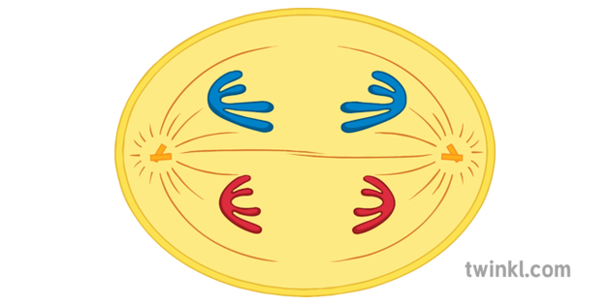
Which stage of mitosis is this?

Slide 10
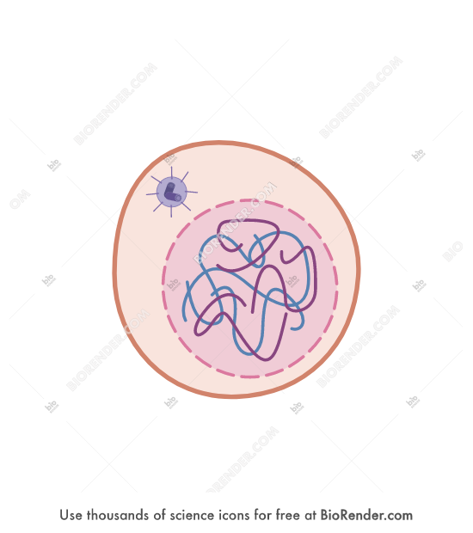
Which stage of mitosis is this?

Slide 11
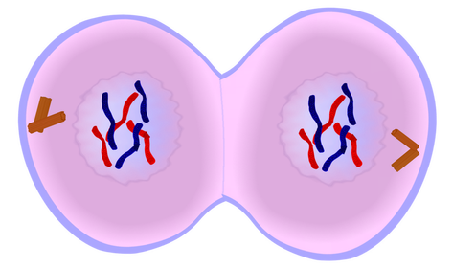
Which stage of mitosis is this?

Slide 12
We will be able to describe the relationship between organelles, cells, tissues, organs and systems
TRACK WITH ME
READ WITH ME
I can put the biological levels of organisation in order
^{I can list different organs}
I can list different organ systems
I can list different tissue types

Slide 13
We will be able to describe the relationship between organelles, cells, tissues, organs and systems
Which is the smallest part of life?
Animal cell
Lung
Muscle tissue
Circulatory system

Slide 14
We will be able to describe the relationship between organelles, cells, tissues, organs and systems
Biological organisation
This is the way in which we describe the smallest unit of life in humans to the largest system in humans.

Slide 15
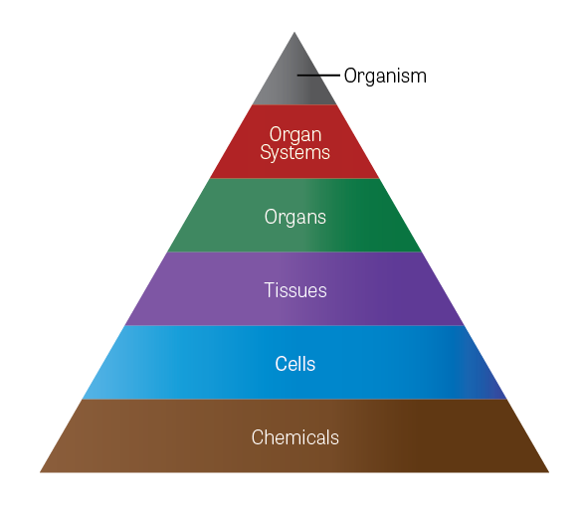
We will be able to describe the relationship between organelles, cells, tissues, organs and systems
Please draw this diagram in your book

Slide 16
We will be able to describe the relationship between organelles, cells, tissues, organs and systems
The smallest part of the body is the cell. This is what carries out the processes that allow the body to survive.
An example is the blood cells.

Slide 17
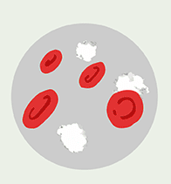
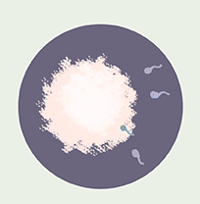
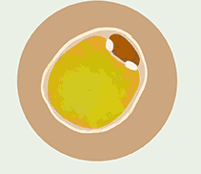
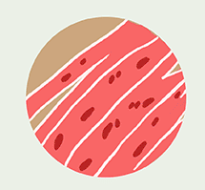
We will be able to describe the relationship between organelles, cells, tissues, organs and systems
Name the cell
Cells can do certain tasks. We call the cells above specialised cells.

Slide 18
We will be able to describe the relationship between organelles, cells, tissues, organs and systems
The next step of Biological organisation is tissues.
These are cells that are grouped together that perform a similar function.

Slide 19
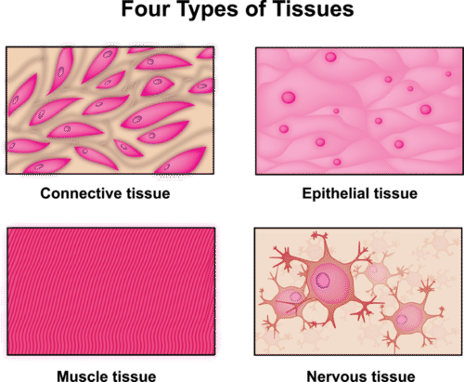
We will be able to describe the relationship between organelles, cells, tissues, organs and systems
There are four different types of tissue.
Connective
Epithelial
Muscle
Nervous

Slide 20
We will be able to describe the relationship between organelles, cells, tissues, organs and systems
Connective tissue supports other tissues and binds them together (bone, blood and lymph tissues).
Epithelial tissue provides a covering (skin and lining of different passages).
Muscle tissue includes muscles that move the skeleton and smooth muscle like that surrounding the stomach.
Nerve tissue is used to send messages around the body.

Slide 21
We will be able to describe the relationship between organelles, cells, tissues, organs and systems
The next step of Biological organisation is organs.
These are two or more tissues that work together to perform the same job.

Slide 22
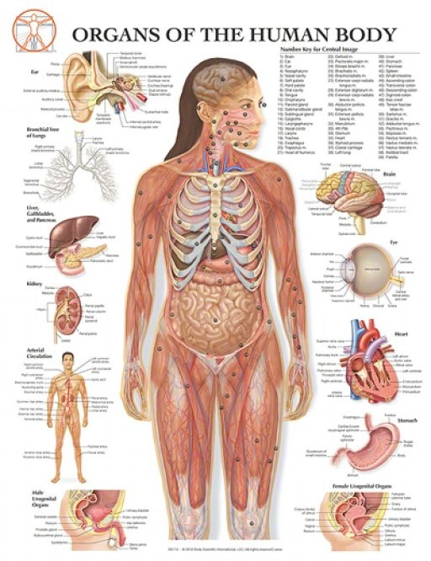
We will be able to describe the relationship between organelles, cells, tissues, organs and systems
Brainstorm
Can you think of as many organs in the human body as possible.
Hint: There are 78!

Slide 23
We will be able to describe the relationship between organelles, cells, tissues, organs and systems
The next step of Biological organisation is Organ systems.
These are groups of organs that work together to carry out a complex overall function.

Slide 24
We will be able to describe the relationship between organelles, cells, tissues, organs and systems
HINT
Muscular and skeletal system won’t be covered in too much depth as it crosses over with health.
There are 12 organ systems in the human body.
Skeletal circulatory
Nervous excretory
Muscular Reproductive
Respiratory Digestive
Endocrine
Immune
This year
Next year

Slide 25
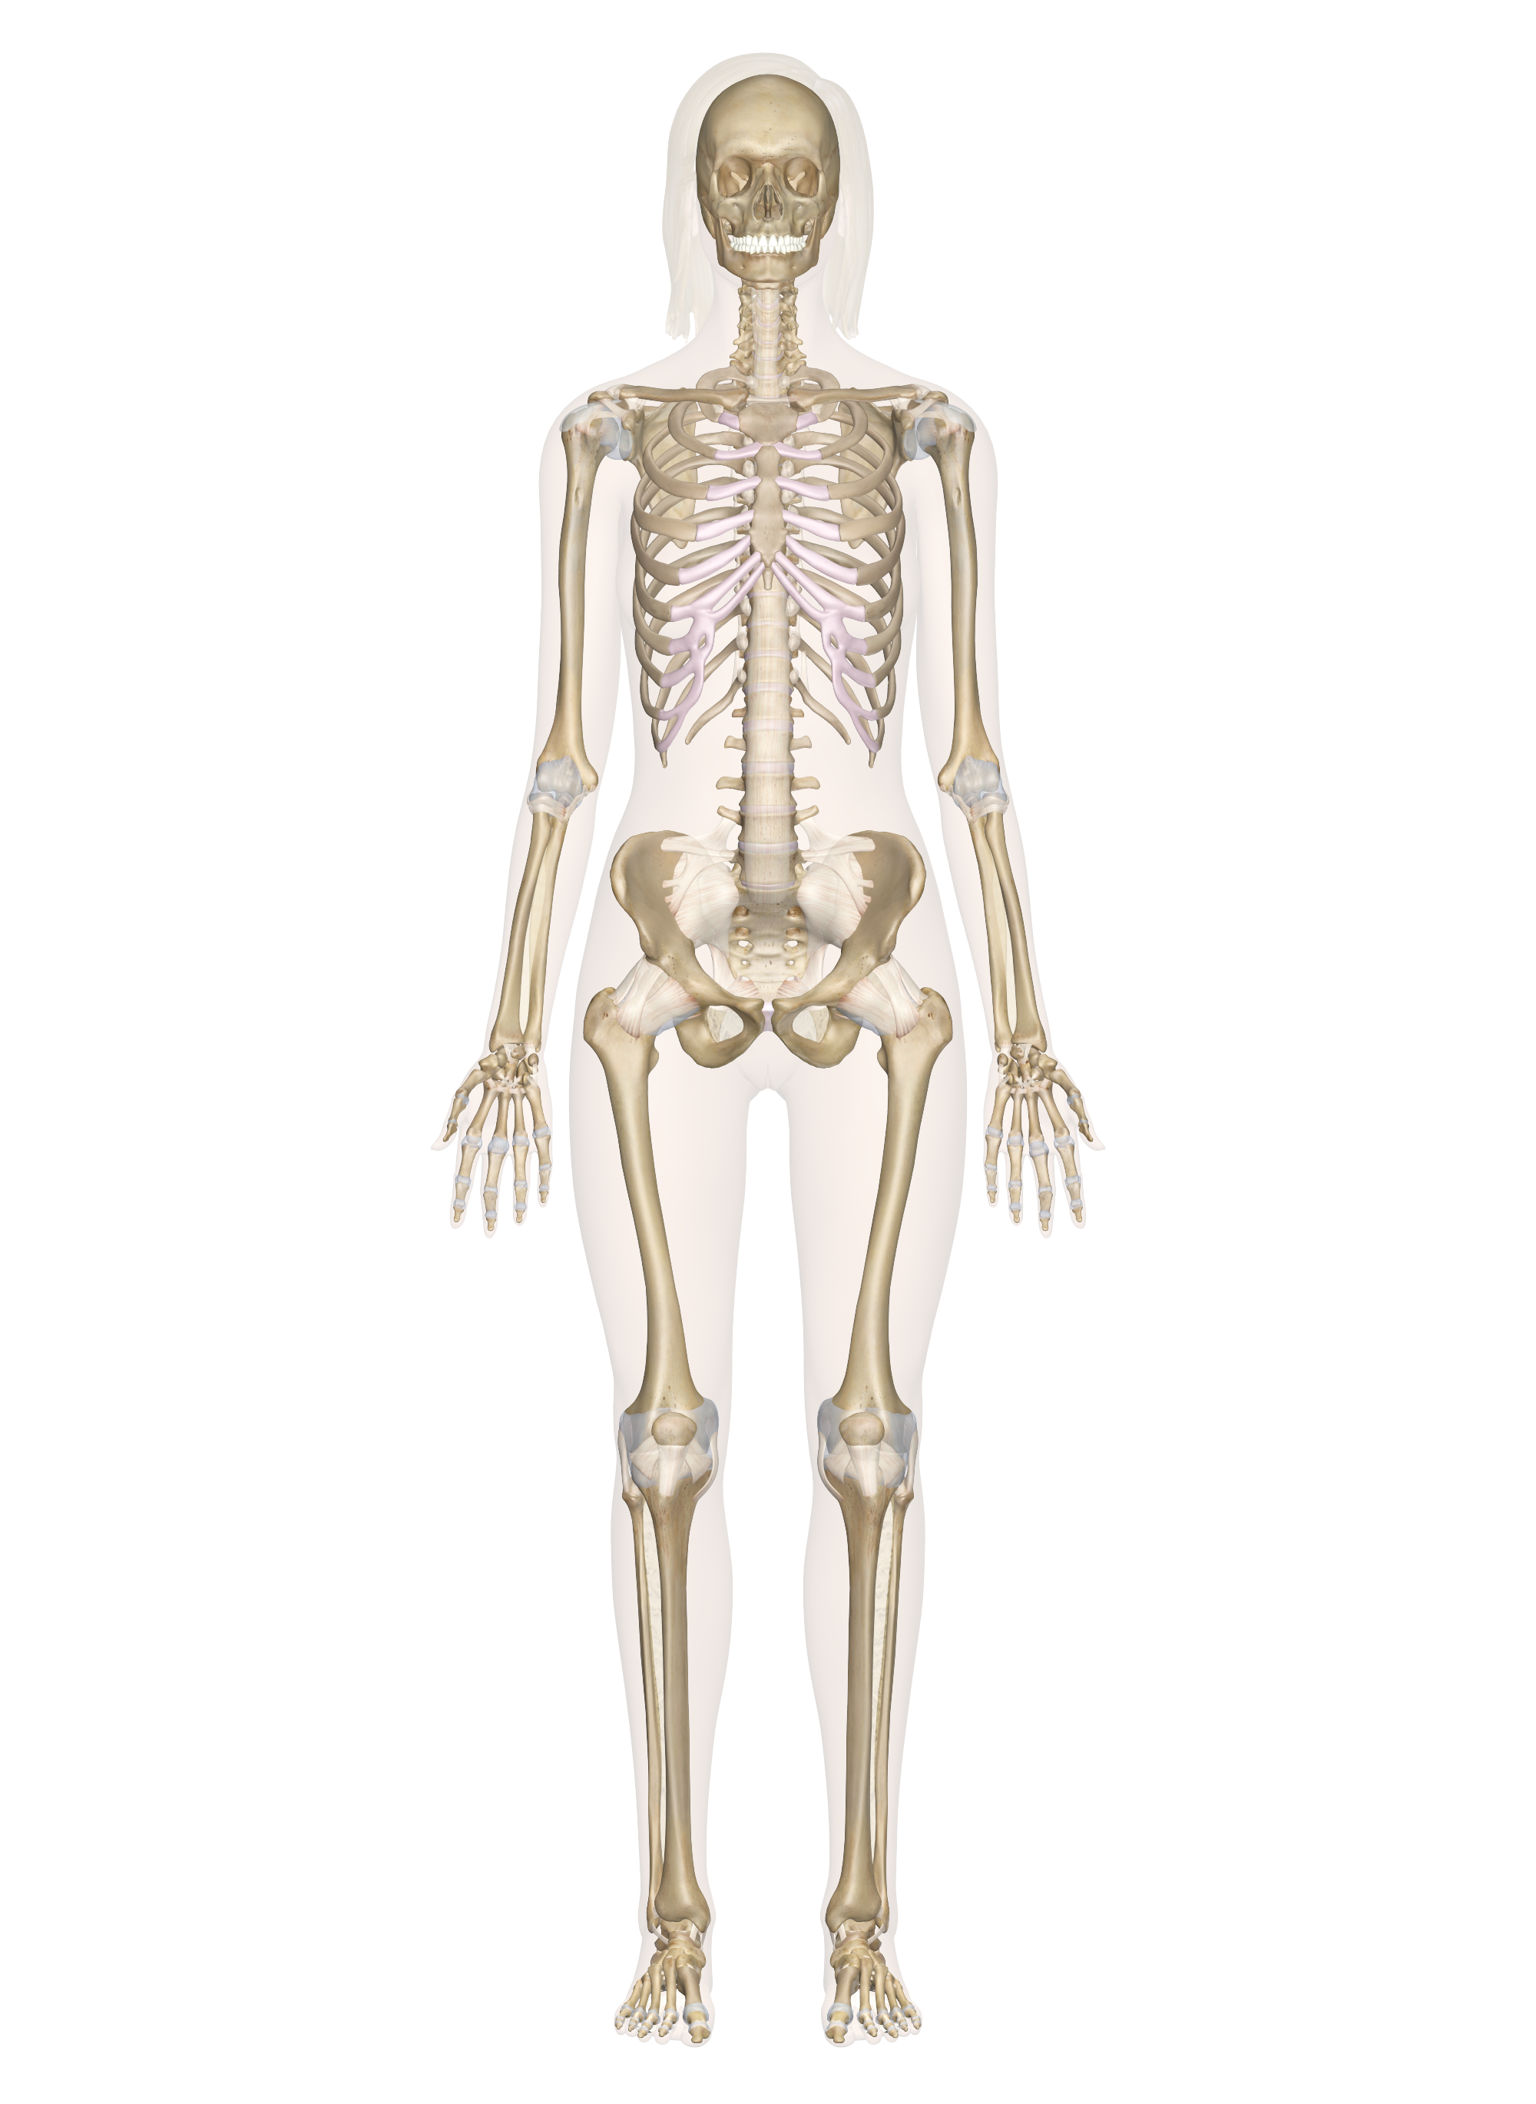
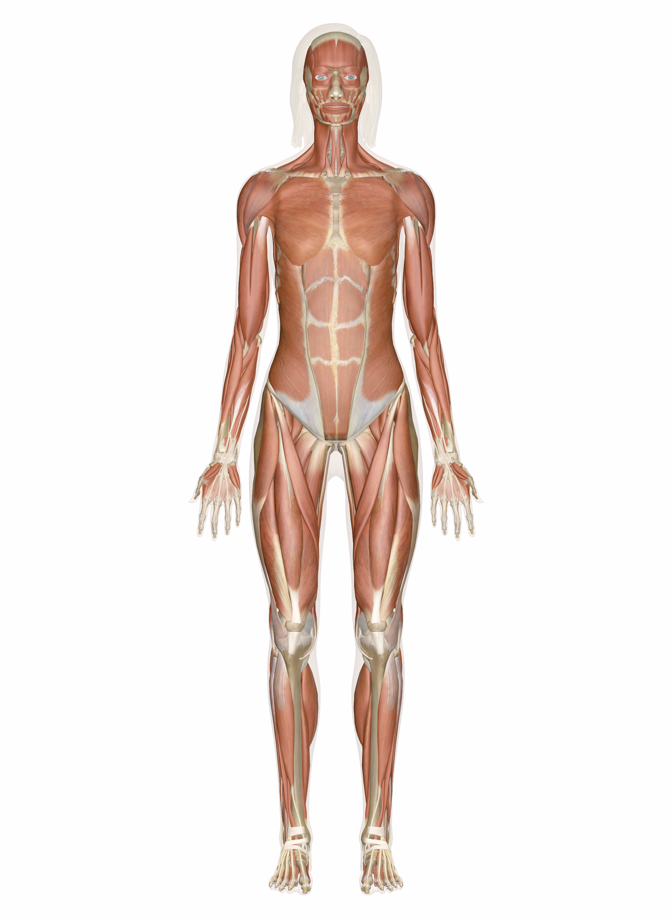
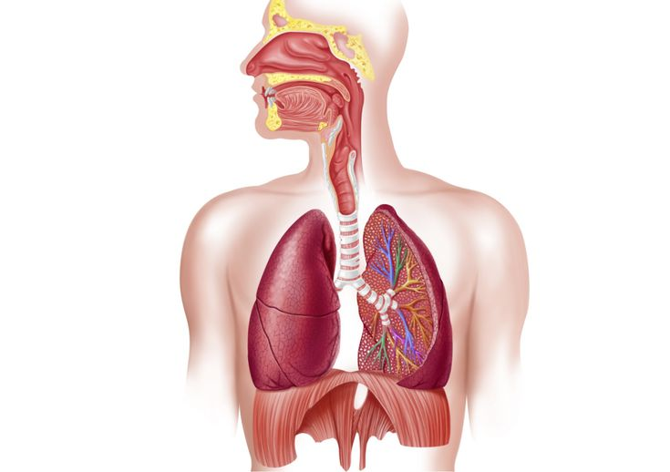
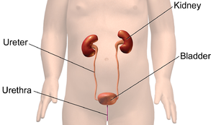
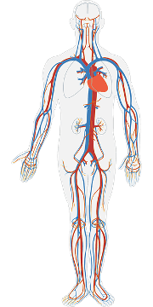
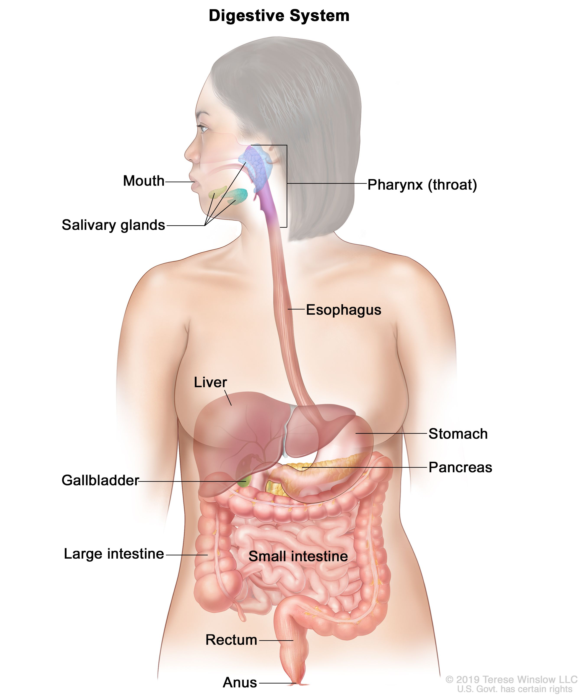
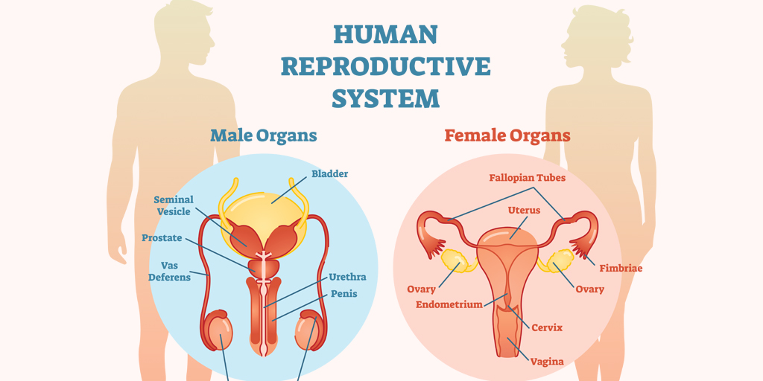
HINT
Scaffolding for students
We will be able to describe the relationship between organelles, cells, tissues, organs and systems
Match the image and the label

Slide 26
We will be able to describe the relationship between organelles, cells, tissues, organs and systems
Questions
Name the four different tissue types
Name (4) different types of cells
Explain the relationship between organs and tissues
Identify which organs are involved in the circulatory system
Identify the organs in the digestive system
Describe which organ systems may work together

Slide 27
We will be able to describe the relationship between organelles, cells, tissues, organs and systems
TRACK WITH ME
READ WITH ME
I can put the biological levels of organisation in order
^{I can list different organs}
I can list different organ systems
I can list different tissue types

